Slide 1
Workshop Repository
https://github.com/scgordon/MILE4FAIRness

Slide 2


Is Your Metadata in Shape? Visualizing quantitative analyses of metadata to support the varying FAIR information needs of an interdisciplinary community of users
Sean Gordon
16th of July, 2019

Slide 3
The story
A Catalog’s Purpose
Find
Access
Interoperate
Reuse
Notes:
Metadata catalogs serve a specific purpose. These catalogs are designed to help users find, access, interoperate and reuse the resources they describe. It is difficult to keep a metadata catalog in shape. For example, records need new versions because a dataset is ongoing, new best practices are identified, or the need to comply with requirements to join a federated discovery platform.
Catalogs are increasingly diverse and rapidly growing in size which increases the complexity of metadata curation and the need for constant evaluation to stay in shape. Without good metadata it is difficult for users to discover datasets likely to be useful, but more importantly good metadata is essential for converting that dataset into information so it can be transformed into knowledge and understood and used in novel ways.

Slide 4
The story
Continual Catalog Curation
To be good stewards curators need to ensure effective and equitable FAIRness for users to Find, Access, Interoperate, and Reuse the catalog’s resources throughout the Data Lifecycle.
http://www.dcc.ac.uk/resources/curation-lifecycle-model
Notes:
Continual improvement through the lifecycle
Now what do I mean by

Slide 5
Metadata Recommendations
There are a wide variety of ways people study the earth, and almost as many different ways that they structure their metadata.
These communities have different standards that they use, and different recommendations they require and suggest for their metadata.
These standards based and organizational recommendations shape the metadata records that are created in a discipline.
Notes:
A wide variety of standards and metadata needs

Slide 6
Earth Sciences: many communities, many needs
How can curators for earth science datasets and other resources include an understanding of the variety in information needs and provide actionable curation workflows to address the varying needs in order to ensure resources are FAIR for all potential users?
We can utilize reports from many recommendations to determine iterative improvement of the collections that most need improvement so we can provide documentation for resources that equitably support all users
https://cadmans.weebly.com/introduction-to-earth-science.html
Notes:
Lets look at evaluation techniques used at earth science data repositories to analyze metadata for datasets to provide quantitative measures of the metadata needs of multiple earth science and interdisciplinary communities.

Slide 7
Discipline Specific Curation
We can apply a community’s FAIR recommendation to a record or catalog to provide curation guidance reports.
However, improving the documentation based on a single discipline’s information needs does not serve all potential users.
https://www.diversecymru.org.uk/wp-content/uploads/Equality-Does-Not-Mean-Justice.jpg
Notes:
Data driven improvement removes the bias of the team, allowing resources to go to those with the most underserved metadata needs

Slide 8
“Science isn’t complete until it’s communicated”
Metadata is created for the needs of the originating community.
The catalog serves a diverse community of scholars.
They have different information needs to discover and use a resource.
Quality metadata is subjective.
The needs of the user are paramount.
For equitable discovery and access of resources the documentation use cases of the originating discipline are necessary but not sufficient.
http://blogs.nature.com/naturejobs/2017/11/20/why-scientists-should-communicate-science-getting-to-the-heart-of-the-matter/
Notes:
Quality metadata is subjective. The needs of the user are paramount.
However metadata is created for the needs of the originating community, or the repository it resides at.
For equitable discovery and access of resources the documentation use cases of the originating discipline are not enough.
The Library serves a diverse community of scholars. They have different perspectives and interests that drive their research, different levels of digital literacy, different experiences as humans and need different metadata to discover and use a Library resource.
How can the ingest, creation, and curation of metadata for digital objects and collections include an understanding of the variety in metadata needs and provide actionable workflows to address it in order to ensure discovery and access?

Slide 9
Equal Curation vs Equitable Curation
We can apply this framework to provide evaluation reports for many recommendations.
We can utilize the reports to determine which iterative improvements to make to the catalog so we can provide documentation for resources that equitably support all current and potential users of the catalog.
https://www.diversecymru.org.uk/wp-content/uploads/Equality-Does-Not-Mean-Justice.jpg
Notes:
Data driven improvement removes the bias of the team, allowing resources to go to those with the most underserved metadata needs

Slide 10
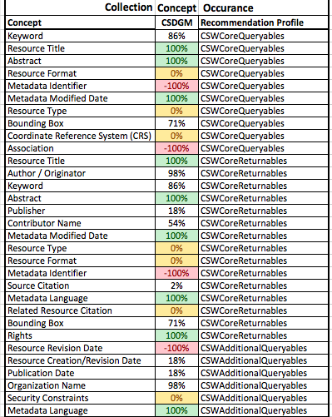
Quantitative data for recommendations compliance
Identify concepts that are missing from the standard, missing from collection, complete, or partially used.
-100% = Concept Not in Dialect
0% = Concept Not in Collection
100% = Concept in All Records
54% = Concept in Some Records

Slide 11
A catalog is more than just one collection
When you have multiple contributors, or collections in your catalog, looking at the recommendation data can be difficult.
Comparing completeness for different recommendations may also help to direct improvement efforts.
Comparing between ingest, native and export standards to ensure quality across discovery platforms for the catalog.
Curators may also want to track improvement over time to compare with citation metrics to justify continued curation of the catalog.
Notes:
Tech and trends that can be leveraged

Slide 12
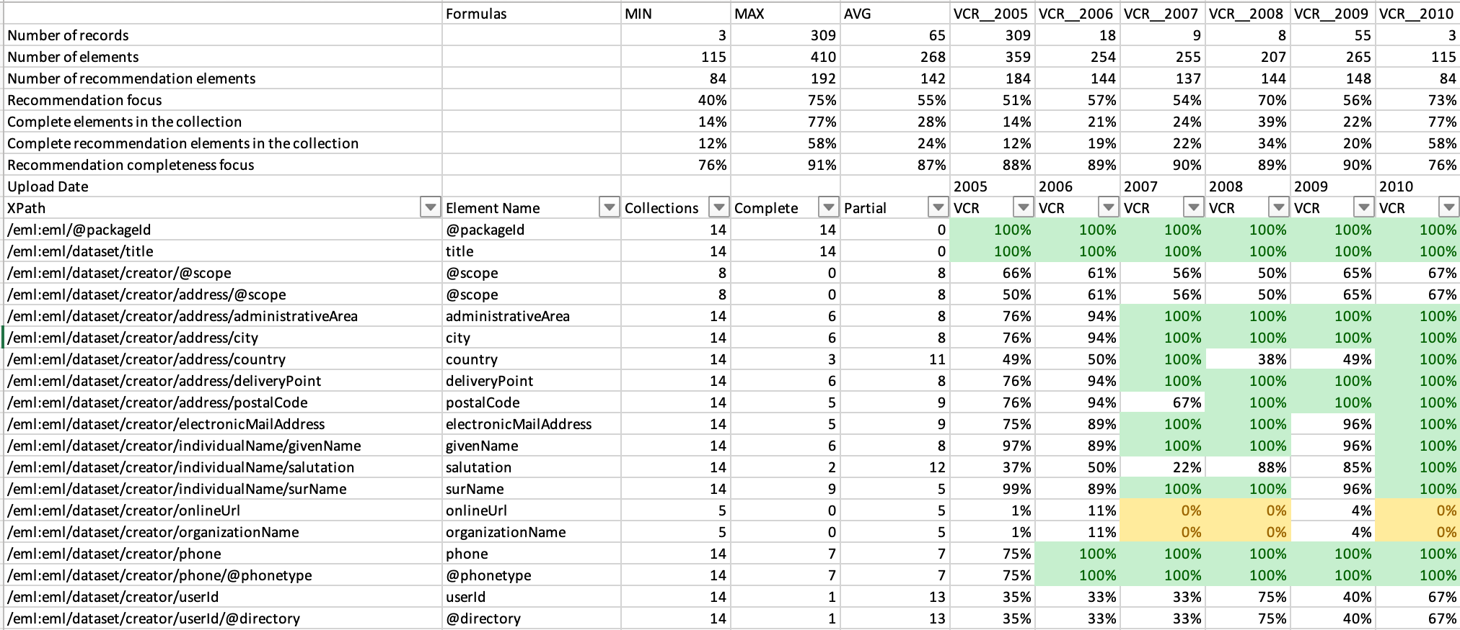
Comparison Report
Notes:
This report is for one site over

Slide 13
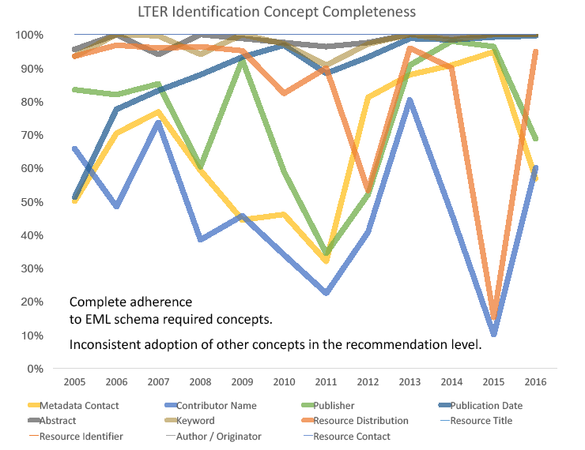
Difficulty in using typical visualizations
Bar charts or histograms for each metadata concept quickly becomes difficult to understand the whole picture.
Parallel lines for each concept are also fraught with problems in conveying overall completeness while still offering precision.
Notes:
Since these information needs are often outside the experience and knowledge of a discipline’s curators, simple review of the records in a catalog may be insufficient. How can curators and catalogers quickly evaluate the likelihood that a record in the catalog will contain all of the metadata needed by a potential user of any resource described, and which collections and records need what specific types of improvement?

Slide 14
A Metadata Metaphor
Metadata as a key.
Lock as information needs.
Pins as tests for compliance with metadata concepts.
Quality metadata unlocks information from data.
https://en.wikipedia.org/wiki/Pin_tumbler_lock
Notes:
We can think of metadata as a key to unlock information from data’s door. Keys have a shape to fit a specific lock. We can think of this lock as a community’s information needs. A good example of expressed information needs would be a metadata standard’s recommendation or a community’s stated best practices, such as the EML Best Practices for LTER Sites (LTER, 2004). Each pin in a locks cylinder can be a specific need such as a title or abstract, even something as complex as methods or as specific as what a column in a table means.
Different communities and organizations will have different needs to unlock information and the visualization will work for any of them, be it discovery or understanding, or to ensure that credit for unique contributions goes where it is due, as with software and data citation efforts.
The lock’s cylinder pins can be as simple as a test for presence/absence of an element in the structure of a document such as the tests used to compare EML and CSDGM producing member nodes in DataONE for Best Practices completeness to determine if community recommendations can improve metadata completeness (Gordon; Habermann, 2018).
Tests can also be a more complex quantifiable that evaluates the content of that element such as with LTER’s Pasta (LTER, 2011) or NCEAS’s Metadata Quality Engine (Slaughter, 2019). Any test can provide a completeness percentage for the collection by aggregating the results for each document.
This means that each community needs a specific shape to their metadata key in order to unlock the information from a dataset. Rather than creating unique key shapes for each community, we can abstract the shape to a circle, and fill it to the extent that records pass the different tests that comprise the community’s information needs.

Slide 15
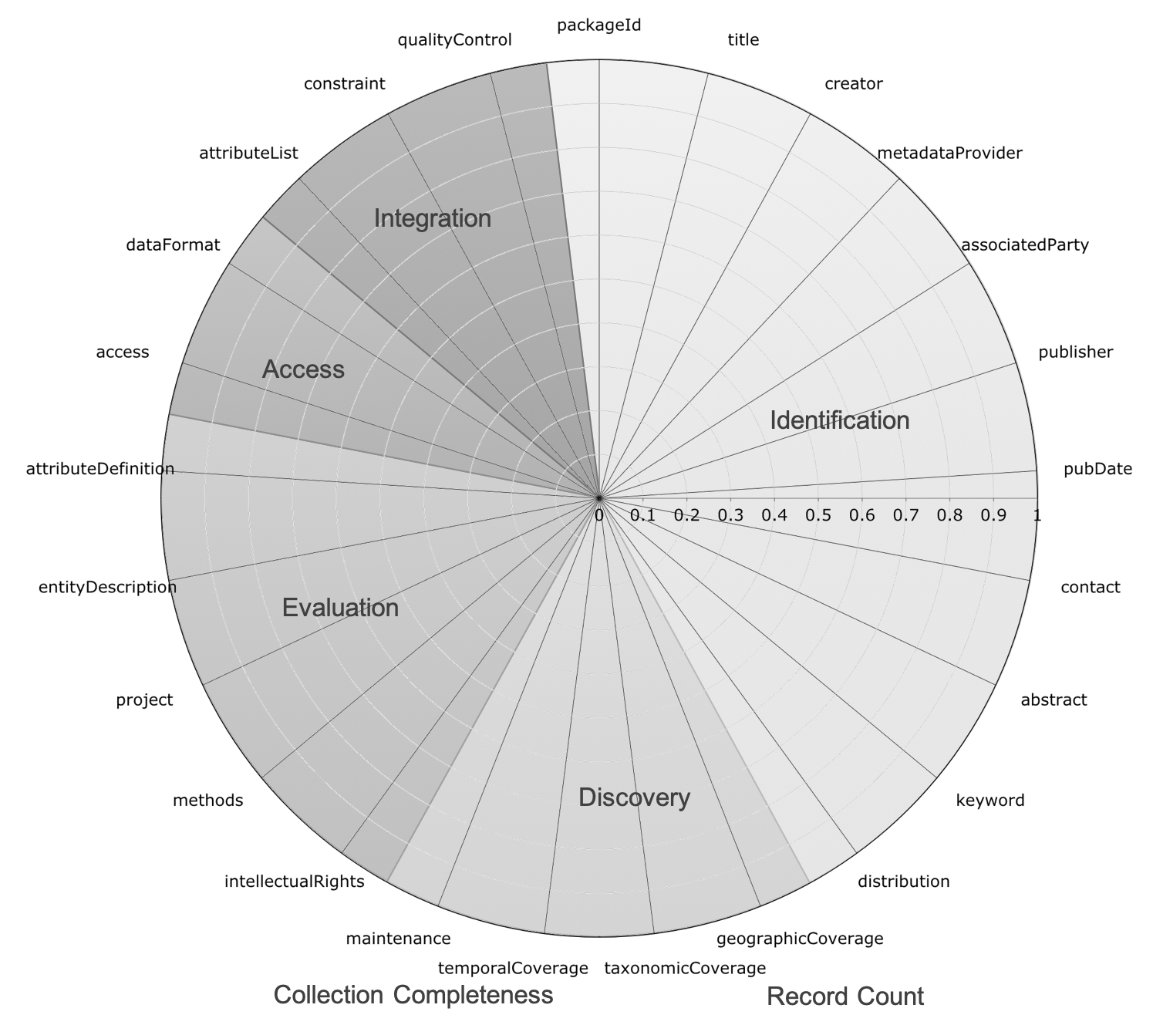
The shape of Metadata Fitness
Unlike a body builder, getting metadata in shape is not a matter of toning and sculpting, but filling out the shape
Notes:
To visualize a metadata catalog or collection’s ability to meet the information needs of a community, plot each element as an axis in a polar chart and then quantify from 0 to 1 how many records pass whatever test desired to evaluate the element (Gordon, 2019).
To extend the fitness metaphor, we need a shape of completeness that can accommodate varying numbers of tests for determining the fitness of the catalog, or the ability to meet the information needs of the community in question. However, we don’t need this shape to be all buff and lean edges like Ahnold. The shape of fitness proposed here is fluffier and more rounded (Chris Farley). This circle is an easier way to keep the shape of completeness consistent and easily identifiable.
A visualization that can provide these insights is proposed here and its use is demonstrated with a dataset of Ecological Metadata Language (EML) metadata records from sites in the Long-Term Ecological Research Network (LTER) over the period 2005-2018. These collections of records created by a site during a year allow us to see what kind of effect the EML Best Practices for LTER Sites recommendations from 2004 and 2011 have had on the completeness of the community’s information needs over time.
Often, as is the case with LTER’s Best Practices, a community’s information need can be broken up into different needs or use cases. The EML Best Practices for LTER Sites has 5 different use cases they call levels. They are Identification, Discovery, Evaluation, Access, and Integration. These levels can be plotted within a single chart as with Figure 2 (Gordon; Habermann, 2019) or separately depending on focus of inquiry.

Slide 16
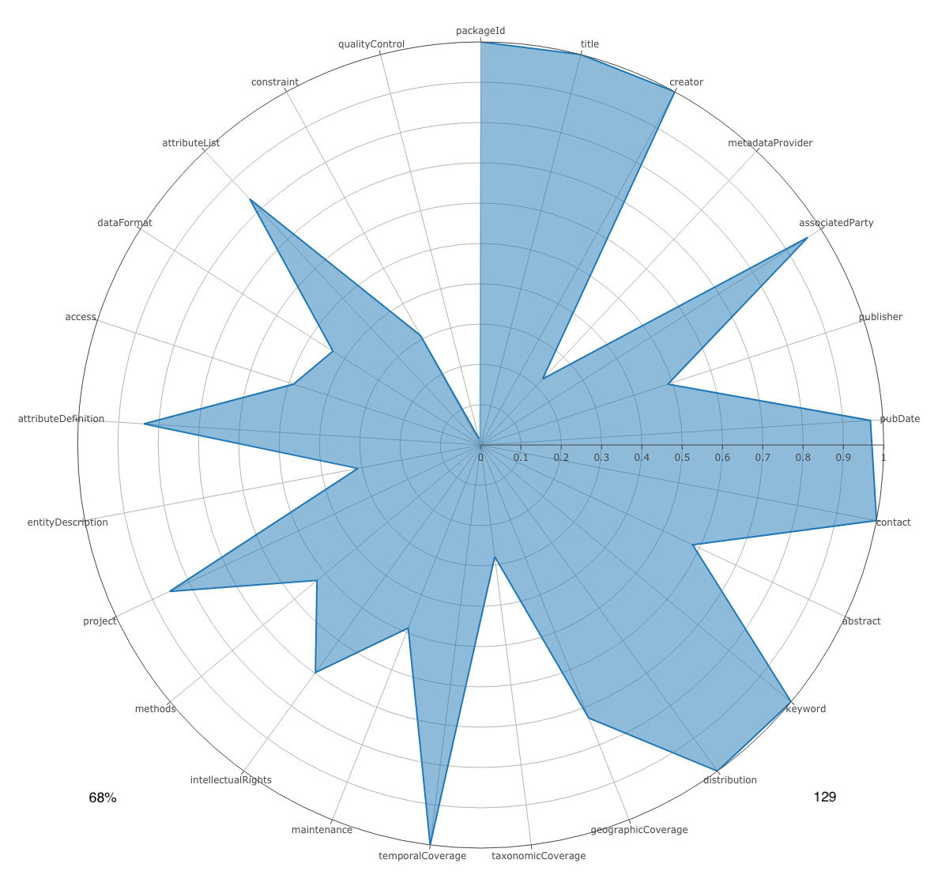
Visualizing the fitness of a collection
Here is an example of the visualization of an information need using the EML Best Practices for LTER Sites elements. The shape expressed in here is calculated using a collection of records from an LTER site.
Notes:
LTER also participates in DataONE, a federated discovery platform spanning many disciplines of science and scholarship. DataONE recently hosted a workshop where the principles of FAIR (Findable, Accessible, Interoperable, and Reusable) were operationalized in order to evaluate metadata records submitted by their member nodes. Using the same time series of site records and a crosswalk of FAIR metadata concepts to EML, we will investigate the sites to see if the improvement efforts of the community have been increasing the FAIRness of LTER metadata for the overall DataONE community.

Slide 17
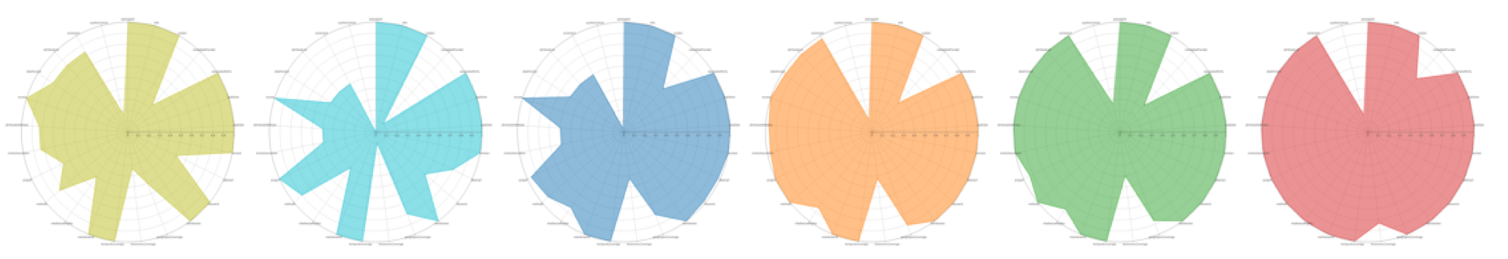
Visualizing change over time
LTER site AND from 2013-2018
Improvement over time
Notes:
Often, as is the case with LTER’s Best Practices, a community’s information need can be broken up into different needs or use cases. The EML Best Practices for LTER Sites has 5 different use cases they call levels. They are Identification, Discovery, Evaluation, Access, and Integration. These levels can be plotted within a single chart as with Figure 2 (Gordon; Habermann, 2019) or separately depending on focus of inquiry.

